Slide 1
密码学：数据完整性

Slide 2
主要内容
数据完整性/消息认证：
散列函数
消息认证码
数字签名

Slide 3
认证/鉴别 Authentication
认证和加密不同。
消息认证是验证消息完整性的一种机制，能发现对消息的篡改或假冒，也确保发送方声称的身份是真实有效的。
使用对称算法可产生消息认证码MAC
使用公钥算法可对消息进行签名
数字签名是一种防止发送方或接收方抵赖的认证技术。
Hash函数是一个单向的消息摘要函数，应用于消息认证和数字签名

Slide 4
认证需求
对网络通信的攻击（4类）
窃听
流量分析
伪装（假冒）
篡改内容
修改顺序
修改时间（包括重放）
发送方抵赖（拒绝承认曾发出过某消息）
接收方抵赖

Slide 5
认证函数
1. 对称加密
2. 公钥加密
3. 消息认证码（MAC）
4. 散列函数（Hash）
基于加密的认证
Notes:
Message authentication code

Slide 6
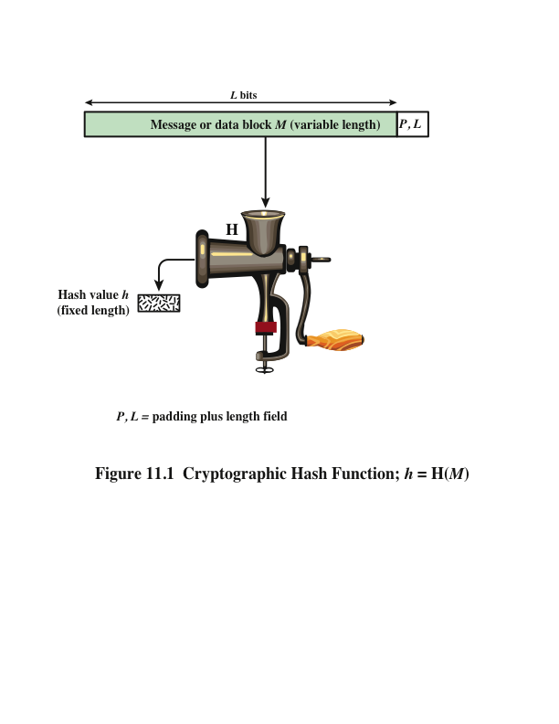
散列函数hash
消息摘要 Message digest
Hash函数将可变长度的数据块M作为输入，产生固定长度的hash值 h = H(M)
作用
保证数据完整性
特性
单向性
抗碰撞(弱、强)

Slide 7
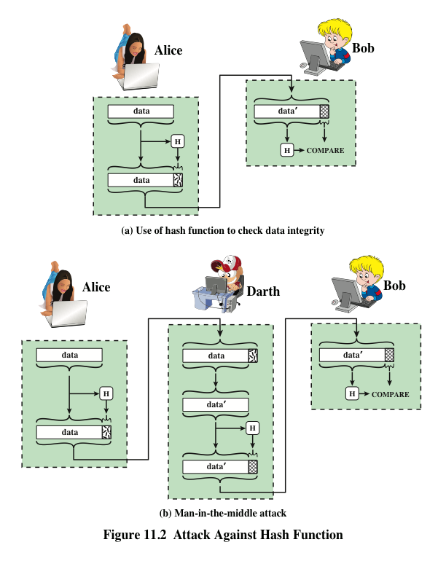
散列函数的应用
Notes:
Message authentication is a mechanism or service used to verify the integrity of
a message. Message authentication assures that data received are exactly as sent
(i.e., contain no modification, insertion, deletion, or replay). In many cases, there is
a requirement that the authentication mechanism assures that purported identity of
the sender is valid. When a hash function is used to provide message authentication,
the hash function value is often referred to as a message digest .
The essence of the use of a hash function for message authentication is as
follows. The sender computes a hash value as a function of the bits in the message
and transmits both the hash value and the message. The receiver performs the same
hash calculation on the message bits and compares this value with the incoming
hash value. If there is a mismatch, the receiver knows that the message (or possibly
the hash value) has been altered (Figure 11.2a).
The hash function must be transmitted in a secure fashion. That is, the hash
function must be protected so that if an adversary alters or replaces the message,
it is not feasible for adversary to also alter the hash value to fool the receiver. This
type of attack is shown in Figure 11.2b. In this example, Alice transmits a data block
and attaches a hash value. Darth intercepts the message, alters or replaces the data
block, and calculates and attaches a new hash value. Bob receives the altered data
with the new hash value and does not detect the change. To prevent this attack, the
hash value generated by Alice must be protected.

Slide 8
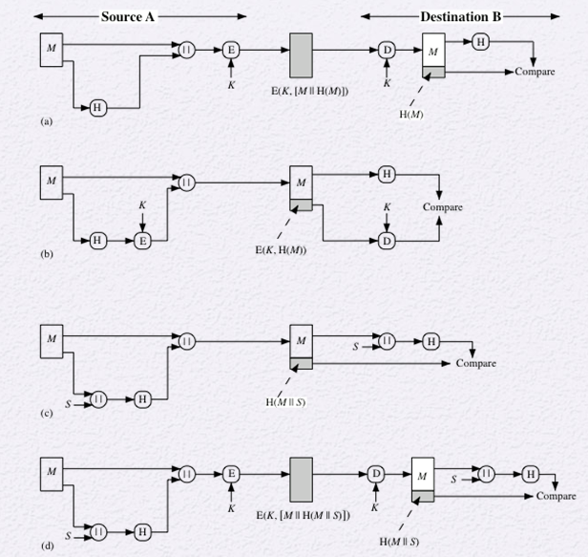
散列函数用于消息认证
Notes:
Figure 11.3 illustrates a variety of ways in which a hash code can be used to
provide message authentication, as follows:
a. The message plus concatenated hash code is encrypted using symmetric
encryption. Because only A and B share the secret key, the message must
have come from A and has not been altered. The hash code provides the structure
or redundancy required to achieve authentication. Because encryption is
applied to the entire message plus hash code, confidentiality is also provided.
b. Only the hash code is encrypted, using symmetric encryption. This reduces the
processing burden for those applications that do not require confidentiality.
c. It is possible to use a hash function but no encryption for message authentication.
The technique assumes that the two communicating parties share a common secret
value S. A computes the hash value over the concatenation of M and S and
appends the resulting hash value to M. Because B possesses S, it can recompute
the hash value to verify. Because the secret value itself is not sent, an opponent
cannot modify an intercepted message and cannot generate a false message.
d. Confidentiality can be added to the approach of method (c) by encrypting the
entire message plus the hash code.
When confidentiality is not required, method (b) has an advantage over
methods (a) and (d), which encrypts the entire message, in that less computation
is required. Nevertheless, there has been growing interest in techniques that
avoid encryption (Figure 11.3c). Several reasons for this interest are pointed out in
[TSUD92].
• Encryption software is relatively slow. Even though the amount of data to be
encrypted per message is small, there may be a steady stream of messages into
and out of a system.
• Encryption hardware costs are not negligible. Low-cost chip implementations
of DES are available, but the cost adds up if all nodes in a network must have
this capability.
• Encryption hardware is optimized toward large data sizes. For small blocks
of data, a high proportion of the time is spent in initialization/invocation
overhead.
• Encryption algorithms may be covered by patents, and there is a cost associated
with licensing their use.

Slide 9
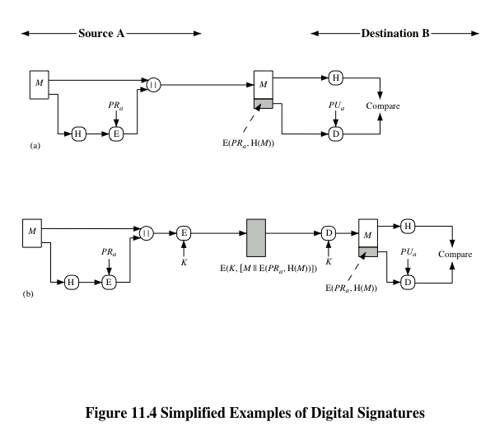
散列函数用于数字签名
Notes:
Figure 11.4 illustrates, in a simplified fashion, how a hash code is used to provide
a digital signature.
a. The hash code is encrypted, using public-key encryption with the sender’s private
key. As with Figure 11.3b, this provides authentication. It also provides a
digital signature, because only the sender could have produced the encrypted
hash code. In fact, this is the essence of the digital signature technique.
b. If confidentiality as well as a digital signature is desired, then the message
plus the private-key-encrypted hash code can be encrypted using a symmetric
secret key. This is a common technique.

Slide 10
其他应用
保护文件完整性
read-only public space
package name
package name
package name
F₁
F₂
F_{n}
⋯
H(F₁)
H(F₂)
H(F_{n})
当用户下载软件包时可以验证其内容是否合法
口令的单向存储
操作系统的口令存储使用口令的散列值：Windows和Linux下的口令存储，可以进一步扩展口令破解、彩虹表等其他内容

Slide 11
单向散列函数（散列函数的安全性）
单向散列函数(单向+散列)
h = H(x)，x称为h的原像
抗冲突性质
给定h，找x满足H(x)=h很难（单向性、原像攻击）
给定x，找y≠x满足H(x)＝H(y)很难 （抗弱碰撞性、第二原像攻击）
找x和y，满足H(x)＝H(y)很难 （抗强碰撞性、碰撞攻击）
举例
MD5、SHA-1、SHA-2、SHA-3、RIPEMD

Slide 12
针对hash函数的攻击
穷举攻击
给定hash值h，试图找到满足H(y)=h 的y。对于m位的hash值，穷举规模为2^{m}。
试图找x和y，满足H(x)=H(y), 其穷举规模相对小，为2^{m/2}。(根据生日悖论)
抗原像攻击： 2^{m}
抗弱碰撞攻击： 2^{m}
抗强碰撞攻击： 2^{m/2}

Slide 13
安全Hash算法的一般结构
Y0
Y1
YL-1
b
b
b
n
n
n
f
n
f
n
f
CVL
IV=
CV0
CV1
CVL-1
IV = 初始值
CV = 链接值
Yi = 第i 个输入数据块
f = 压缩算法
n = Hash码的长度
b = 输入块的长度
CV₀=IV= initial n-bit value
CV_{i}=f(CV_{i-1}, Y_{i-1}) (1 ≤ i ≤ L)
H(M) = CV_{L}

Slide 14
MD系列
作者
Ronald Rivest
http://theory.lcs.mit.edu/~rivest/
MD2、MD4、MD5
MD2/4/5 RFC1319/1320/1321
http://www.ietf.org/rfc/rfc1321.txt
应用
曾经是最广泛的摘要算法
但是散列值太短(128bits)
而SHA-1有160bits
Notes:
Message Digest Algorithm MD5（中文名为消息摘要算法第五版）为计算机安全领域广泛使用的一种散列函数，用以提供消息的完整性保护。该算法的文件号为RFC 1321（R.Rivest,MIT Laboratory for Computer Science and RSA Data Security Inc. April 1992）。
Merkle于1989年提出hash function模型
Ron Rivest于1990年提出MD4
1992年, MD5 (RFC 1321) developed by Ron Rivest at MIT

Slide 15
SHA安全散列算法
SHA：Secure Hash Algorithm
作者 NIST
1993 FIPS PUB 180 SHA {SHA-0}
1995 FIPS PUB 180-1 SHA-1修正版
2001 FIPS PUB 180-2 SHA-2
包括SHA-256/384/512
2007 征集新一代的hash函数标准
2012 NIST公布SHA-3设计中的优胜者

Slide 16
SHA-256/384/512
FIPS 180-2 (draft 2001)
Algorithm MessageSize
BlockSize
WordSize
MDSize
Security
SHA-1 <2⁶⁴ 512 32 160 80
SHA-256 <2⁶⁴ 512 32 256 128
SHA-384 <2¹²⁸ 1024 64 384 192
SHA-512 <2¹²⁸ 1024 64 512 256
安全性security指生日攻击代价

Slide 17
Hash API in OpenSSL
支持的HASH函数
md2、md4、md5、mdc2、rmd160、sha、sha1
struct EVP_MD;
>openssl dgst -sha1 openssl.exe
SHA1(openssl.exe)= 035c7b4e334015fcff3f6d2eb7bd28c0807f24ad
>openssl dgst -md5 openssl.exe
MD5(openssl.exe)= c95a47c158e01de325771691b43445cc
>openssl dgst -ripemd160 openssl.exe
RIPEMD160(openssl.exe)= 63da3e84f6a10a521d2892fa78eb3f877fd1e2e7

Slide 18
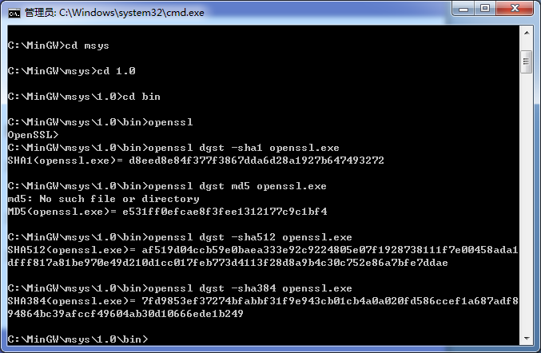

Slide 19
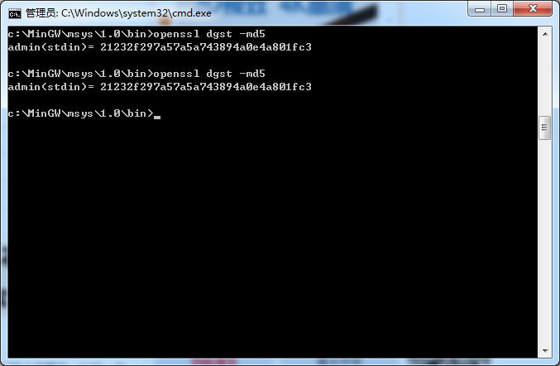

Slide 20
MD5/SHA1 API in OpenSSL
MD5:
int MD5_Init(MD5_CTX *c);
int MD5_Update(MD5_CTX *c, const void *data, unsigned long len);
int MD5_Final(unsigned char *md, MD5_CTX *c);
SHA1:
int SHA1_Init(SHA_CTX *c);
int SHA1_Update(SHA_CTX *c, const void *data, unsigned long len);
int SHA1_Final(unsigned char *md, SHA_CTX *c);

Slide 21
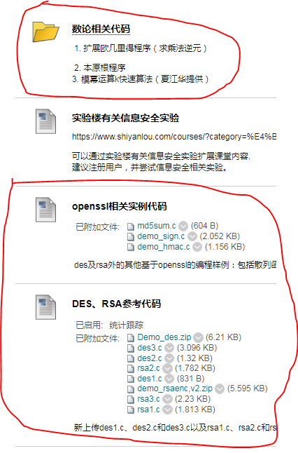
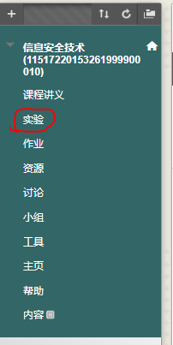
md5sum
md5sum, 计算一个文件的md5校验值
C的代码实例
Python代码实例

Slide 22
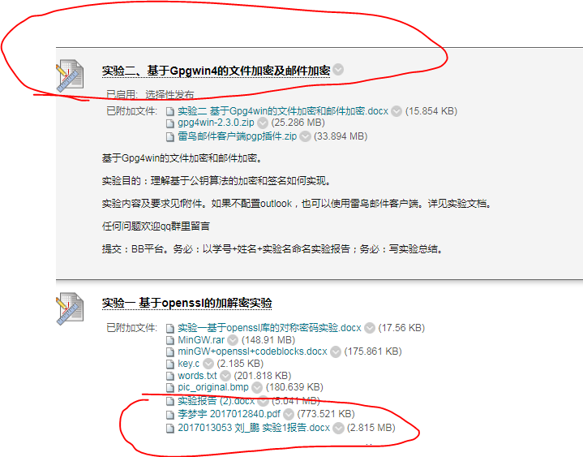

Slide 23
认证函数
1. 对称加密
2. 公钥加密
3. 消息认证码（MAC）
4. 散列函数（Hash）
基于加密的认证
Notes:
消息加密：对整个消息加密后的密文作为认证符
Message authentication code

Slide 24
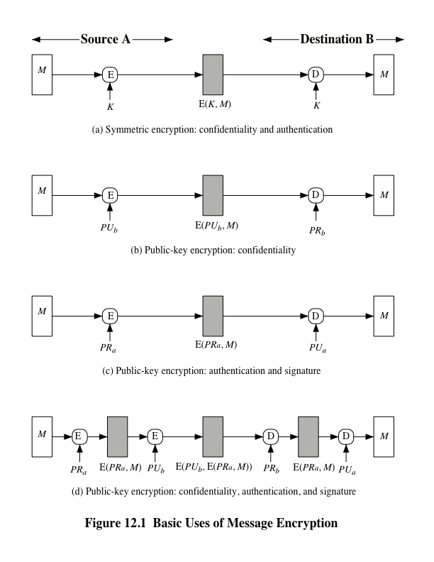
消息加密的基本作用
Notes:
消息加密：对整个消息加密后的密文作为认证符
Consider the straightforward use of symmetric encryption
(Figure 12.1a). A message M transmitted from source A to destination B is encrypted
using a secret key K shared by A and B. If no other party knows the key,
then confidentiality is provided: No other party can recover the plaintext of the
message.
In addition, B is assured that the message was generated by A. Why? The
message must have come from A, because A is the only other party that possesses
K and therefore the only other party with the information necessary to construct
ciphertext that can be decrypted with K . Furthermore, if M is recovered, B knows
that none of the bits of M have been altered, because an opponent that does not
know K would not know how to alter bits in the ciphertext to produce the desired
changes in the plaintext.
So we may say that symmetric encryption provides authentication as well as
confidentiality. However, this flat statement needs to be qualified. Consider exactly
what is happening at B. Given a decryption function D and a secret key K , the
destination will accept any input X and produce output Y = D (K , X ). If X is the ciphertext
of a legitimate message M produced by the corresponding encryption function,
then Y is some plaintext message M . Otherwise, Y will likely be a meaningless
sequence of bits. There may need to be some automated means of determining at B
whether Y is legitimate plaintext and therefore must have come from A.
The implications of the line of reasoning in the preceding paragraph are profound
from the point of view of authentication. Suppose the message M can be any
arbitrary bit pattern. In that case, there is no way to determine automatically, at the
destination, whether an incoming message is the ciphertext of a legitimate message.
This conclusion is incontrovertible: If M can be any bit pattern, then regardless of
the value of X , the value Y = D(K , X ) is some bit pattern and therefore must be
accepted as authentic plaintext.
Thus, in general, we require that only a small subset of all possible bit patterns
be considered legitimate plaintext. In that case, any spurious ciphertext is unlikely
to produce legitimate plaintext. For example, suppose that only one bit pattern in
10⁶ is legitimate plaintext. Then the probability that any randomly chosen bit pattern,
treated as ciphertext, will produce a legitimate plaintext message is only 10⁻⁶ .

Slide 25
对称密码与认证
信源
信宿
M
E
E_{k}(M)
D
M
k
k
A方
B方
D_{k}(E_{k}(M))
(a)对称加密：保密性和认证

Slide 26
对称加密能否提供认证
由于密钥没有第三方知道，所以接收方应该可以确信消息的来源真实性。
这并不绝对，因为存在一种可能性，是对密文的篡改。
问题：对密文的篡改，能否一定被察觉？
Notes:
除非已知加密前明文的结构特征(比如是通常文本)，而且篡改恰好导致解密后明文丧失了原有特征，则可怀疑有篡改

Slide 27
教训：对密文的保护
在加密之前，给明文添加结构特征
x || h(x) // h=crc,md5,sha1
加密
E ( x || h(x), k ) = y
传输有可能出错或被窜改
y会变做y’
解密
判断是否依旧符合 x || h(x) 的结构特征

Slide 28
公钥密码与认证
M
E
EKU_{b}(M)
D
M
A方
KU_{b}(B方的公钥)
B方
KR_{b}
(b) 公钥加密：具有机密性
A->B: E(K_{Ub},M)
提供保密(仅B能解密)
不提供认证

Slide 29
M
E
E KR_{a}(M)
D
M
A方
KR_{a}
KU_{b}
B方
(c) 公钥加密：认证和签名
A->B: E(K_{Ra},M)
提供认证和签名(仅有A可加密,需要某种结构和冗余,任何一方均能验证签名)

Slide 30
公钥密码与认证
M
E
E_{kRa}(M)
E
E_{KUb}(E_{kRa}(M))
A方
KR_{a}
KU_{b}
D
E_{kRa}(M)
D
M
B方
KR_{b}
KU_{a}
(d) 公钥加密：机密性，可认证和签名
A->B: E(KUb,E(KRa, M))
可提供保密；可提供认证和签名
亦需要给明文消息添加结构特征

Slide 31
认证函数
1. 对称加密
2. 公钥加密
3. 消息认证码（MAC）
4. 散列函数（Hash）
Notes:
Message authentication code

Slide 32
消息认证码 MAC
消息认证码：是一种认证技术，它利用密钥生成一个固定长度的短数据块(MAC)，并将该数据块附加在消息之后。（假定双方共享密钥）
发送方利用密钥从明文产生一个固定长度的短数据块，和消息一起传输；
接收方对收到消息用相同的密钥进行相同的计算，得出新的MAC，并与接收到的MAC比较，以判断消息是否被改动过，以及消息是否来自真正的发送方。
MAC函数
计算明文M在密钥K的作用下的特征码
M || MAC(M, K)
验证时，判断明文M和MAC码是否一致

Slide 33
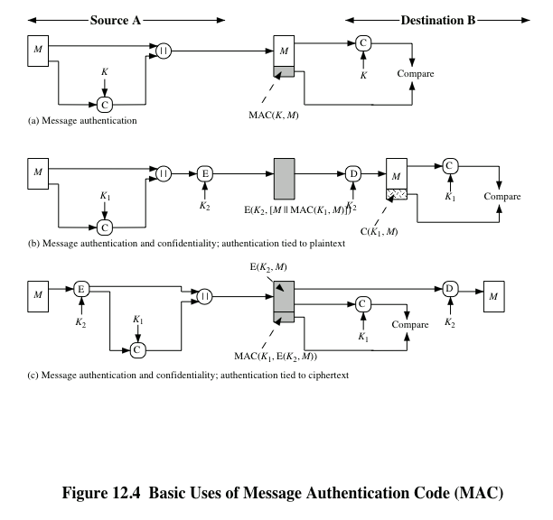
Notes:
An alternative authentication technique involves the use of a secret key to generate
a small fixed-size block of data, known as a cryptographic checksum or MAC, that is
appended to the message. This technique assumes that two communicating parties,
say A and B, share a common secret key K . When A has a message to send to B, it
calculates the MAC as a function of the message and the key:
MAC = C(K , M )
where
M = input message
C = MAC function
K = shared secret key
MAC = message authentication code
The message plus MAC are transmitted to the intended recipient. The recipient
performs the same calculation on the received message, using the same secret key,
to generate a new MAC. The received MAC is compared to the calculated MAC
(Figure 12.4a). If we assume that only the receiver and the sender know the identity
of the secret key, and if the received MAC matches the calculated MAC, then
1. The receiver is assured that the message has not been altered. If an attacker
alters the message but does not alter the MAC, then the receiver’s calculation
of the MAC will differ from the received MAC. Because the attacker is assumed
not to know the secret key, the attacker cannot alter the MAC to correspond
to the alterations in the message.
2. The receiver is assured that the message is from the alleged sender. Because
no one else knows the secret key, no one else could prepare a message with a
proper MAC.
3. If the message includes a sequence number (such as is used with HDLC, X.25,
and TCP), then the receiver can be assured of the proper sequence because an
attacker cannot successfully alter the sequence number.
A MAC function is similar to encryption. One difference is that the MAC
algorithm need not be reversible, as it must be for decryption. In general, the MAC
function is a many-to-one function. The domain of the function consists of messages
of some arbitrary length, whereas the range consists of all possible MACs and all
possible keys. If an n -bit MAC is used, then there are 2^{n} possible MACs, whereas
there are N possible messages with N >> 2^{n} . Furthermore, with a k -bit key, there
are 2^{k} possible keys.
The process depicted in Figure 12.4a provides authentication but not confidentiality,
because the message as a whole is transmitted in the clear. Confidentiality
can be provided by performing message encryption either after (Figure 12.4b) or
before (Figure 12.4c) the MAC algorithm. In both these cases, two separate keys are
needed, each of which is shared by the sender and the receiver. In the first case, the
MAC is calculated with the message as input and is then concatenated to the message.
The entire block is then encrypted. In the second case, the message is encrypted
first. Then the MAC is calculated using the resulting ciphertext and is concatenated
to the ciphertext to form the transmitted block. Typically, it is preferable to tie the
authentication directly to the plaintext, so the method of Figure 12.4b is used.

Slide 34
MAC
讨论
MAC不需要可逆
为了方便，MAC码通常较短
实现MAC函数不排斥使用对称加密算法
实现MAC函数希望使用比加密更高效的方法
为防范重放攻击，加注时间、报文序号
对称MAC不能提供签名特性
因为产生MAC的密钥为两方所有
基于分组密码的MAC和基于HASH的MAC

Slide 35
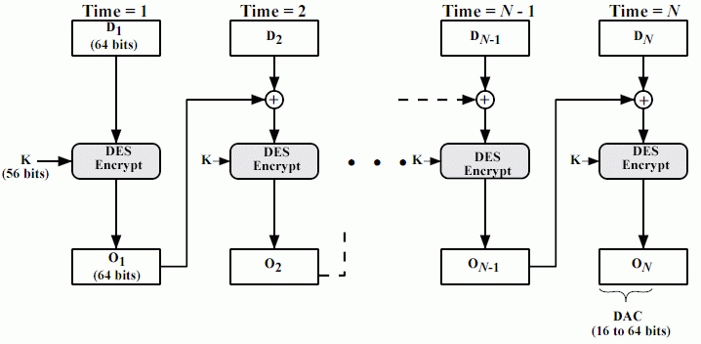
CBC模式最后分组做为数据认证码DAC
IV
FIPS PUB 113数据认证算法DAA
Notes:
FIPS-113以CBC模式为基础，但有变化

Slide 36
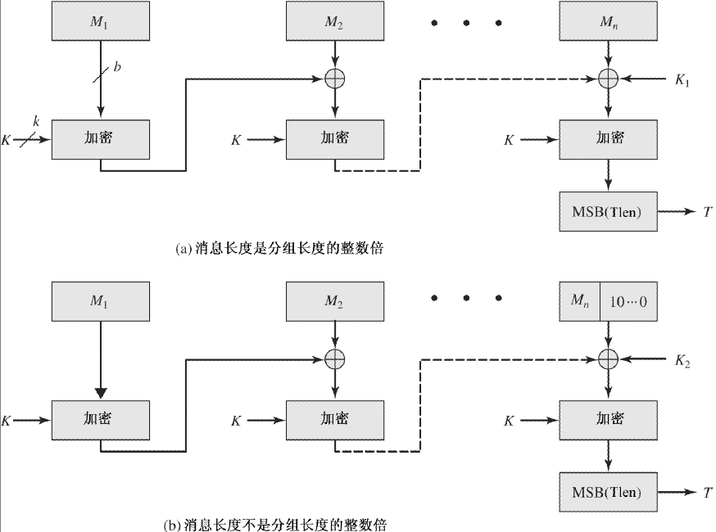
基于密码的认证算法CMAC
FIPS-113（K1/K2由K衍生）

Slide 37
可否不使用加密方法产生MAC码？
生成MAC没有必要整个报文被加密
速度、进出口障碍
不需要能恢复原文
MAC的计算过程只需体现明文的特征唯一
Key是必要的
基于HASH函数的方法HMAC
把散列函数和Key结合得MAC
HMAC = Hash_{Key}(Message)

Slide 38
HMAC
基于散列函数的MAC码算法（HMAC）
把HASH值和一个Key结合起来
既能用当前的HASH函数，又易升级为新的HASH函数，并能保持和散列函数一样安全性
简单，并易进行密码学分析
HMAC(K,M) =
H[ (K⁺⊕opad) || H[(K⁺⊕ipad)||M] ]

Slide 39
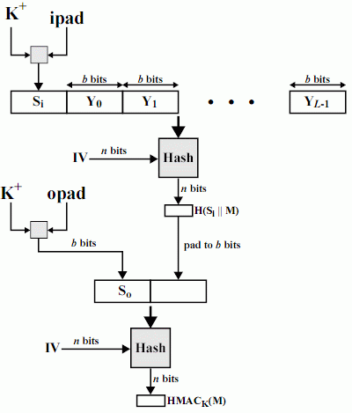
HMAC
K＋ 填充0至bbits Yi 报文分组 ipad 0x36*b/8 opad 0x5C*b/8 IV 依赖于Hash
Notes:
K+为使K为b位长而在K左边填充0后得到的结果。ipad和opad为定值

Slide 40
MAC/HMAC的安全性
攻击加密算法
（如果有使用加密算法）
攻击Hash函数
单向
找碰撞报文 // Hash值大小
生日攻击
攻击使用方法
不正确的实现和使用方式

Slide 41
HMAC程序(in OpenSSL)
unsigned char *mac = HMAC(evp_md_md5, key, sizeof(key), message, strlen(message), md, &md_len);
直接计算MAC数据，通过evp_md， 密钥，密钥数据长度len，计算的数据保存在message，计算结果保存在md中，长度md_len;
Notes:
HMAC是计算MAC的一种方法，有密钥参与计算，不采用HASH算法，对数据做hash计算，并用密钥加密，计算出MAC数值；
void HMAC_CTX_init(HMAC_CTX *ctx);
初始化ctx，在计算MAC之前必须调用此函数；
void HMAC_CTX_cleanup(HMAC_CTX *ctx); 将ctx中密钥数据及其他相关数据清楚，如果不再计算ctx，需要调用此函数，将ctx中数据清除；
int HMAC_Init(HMAC_CTX *ctx, const void *key, int len, const EVP_MD *md); /* deprecated */ 初始化ctx数据，在ctx中复制EVP_MD方法，密钥数据，密钥数据长度为len；此函数在0.96版本之后不再被支持。
int HMAC_Init_ex(HMAC_CTX *ctx, const void *key, int len,
const EVP_MD *md, ENGINE *impl); 初始ctx数据，在ctx中复制EVP_MD方法，密钥数据，密钥数据长度为len， impl可以为NULL；
int HMAC_Update(HMAC_CTX *ctx, const unsigned char *data, size_t len);
此函数可以被重复调用，将数据块加入到计算结果中，数据缓冲区data，数据长度为len；
int HMAC_Final(HMAC_CTX *ctx, unsigned char *md, unsigned int *len);
计算出的MAC数据放置在md中，用户需要保证md数据有足够长的空间，长度为len；
unsigned char *HMAC(const EVP_MD *evp_md, const void *key, int key_len, const unsigned char *d, size_t n, unsigned char *md, unsigned int *md_len);
直接计算MAC数据，通过evp_md,密钥，密钥数据长度len，计算的数据保存在d，长度为n，计算结果保存在md中，长度md_len;
int HMAC_CTX_copy(HMAC_CTX *dctx, HMAC_CTX *sctx);
复制ctx；
dctx： 目标ctx；
sctx：源ctx；

Slide 42
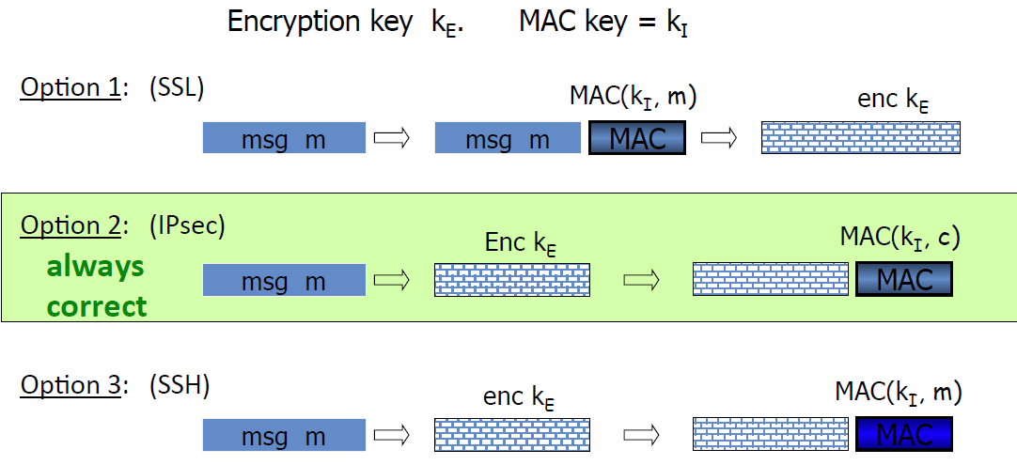
MAC和加密的混合（认证和加密）
防监听和防篡改
先认证再加密
先加密再认证
独立进行加密和认证

Slide 43
小结
对MD5/SHA-1算法的成功攻击是近几年密码学的主要进展之一。目前，MD5算法的强抗碰撞特性被否决，但是弱抗碰撞特新仍保持，因此对实际应用的影响还不大，但是对MD5的信任已经动摇，设计新的Hash算法的行动已经开始。当前倾向使用更长散列值的算法，如SHA-512，以及SHA-3等。
消息认证码的构造方法：
CBC-MAC (用于银行：ANSI X9.9, X9.19, FIPS 186-3)
HMAC (互联网协议: SSL, IPsec, SSH, …)
Notes:
ANSI：美国国家标准学会（AMERICAN NATIONAL STANDARDS INSTITUTE: ANSI）

Slide 44
主要内容
数据完整性/消息认证：
散列函数
消息认证码
数字签名

Slide 45
数字签名
数字签名由公钥密码发展而来，它在网络安全方面具有重要的应用，包括
身份认证、数据完整性、数据源认证、不可否认性等
在网络应用当中，在收发双方未建立起完全的信任关系且存在利害冲突的情况下，通信双方存在互相欺骗和伪造的可能，单纯的消息认证就显得不够。
因为消息认证码等技术收方双方共享密钥，无法解决这一问题，需要数字签名技术来解决
抗抵赖业务中，有数据源发证明的抗抵赖和有交付证明的抗抵赖的实现都需要数字签名技术
再次强调：数字签名是密码学发展过程中的最重要的概念之一。数字签名可以提供其他方法难以实现的安全性---尤其是抗抵赖的认证技术。

Slide 46
考察手写签名的特性
签名的含义
签名者慎重表达认可文件内容的意向的行为
主要形式
手写签名、签章、手指纹印(其他生物技术)
特性
不可伪造，特异性
不可重用，日期和时间相关性
不可改变，能发现涂改、转移意义或用途
不可抵赖，能够质证
可仲裁的，可做为法律证据

Slide 47
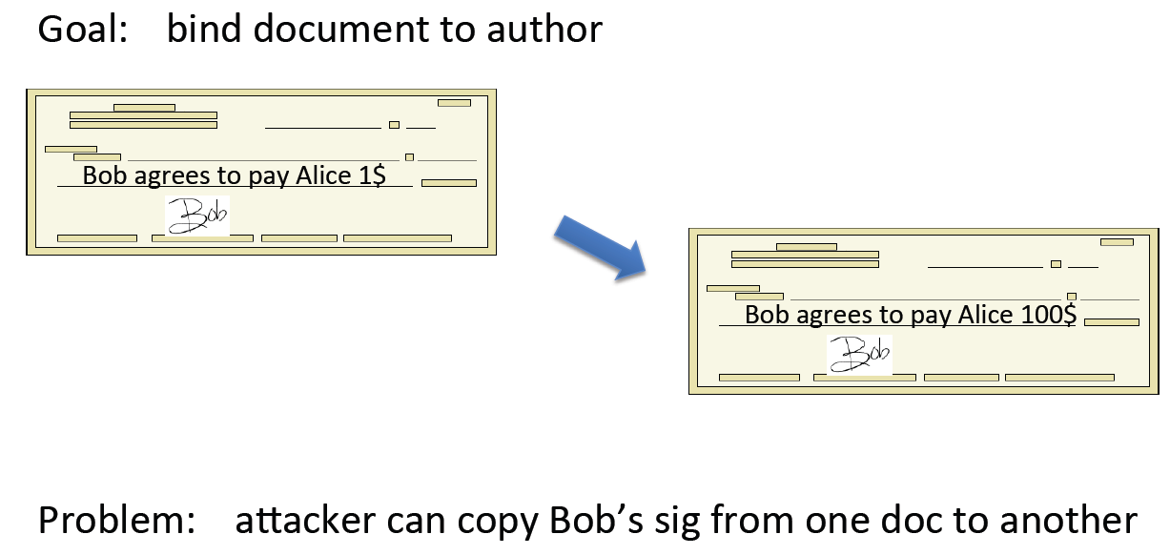
数字签名: 要适应的新变化
数字签名 手写签名
数字文件 纸版文件
数字小文件 手写字（签章）
如何绑定? 同一页纸

Slide 48
手写签名的数字化改造
数学支持－签名函数
被签署的是文件(大文件)
签名生成另外一个文件(小文件)
签名过程一定有签署人的身份和某种秘密(别人不知的)参与
简单易行
计算/存储
身份和秘密
身份和秘密
报文
报文（大）
签名函数
报文
报文（大）
签名函数
签名（小）
签名（小）

Slide 49
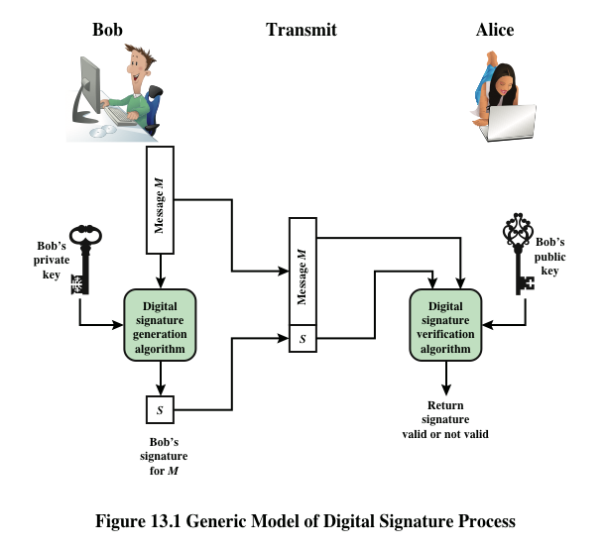
Notes:
Figure 13.1 is a generic model of the process of making and using digital signatures.
Bob can sign a message using a digital signature generation algorithm. The
inputs to the algorithm are the message and Bob’s private key. Any other user, say
Alice, can verify the signature using a verification algorithm, whose inputs are the
message, the signature, and Bob’s public key.

Slide 50
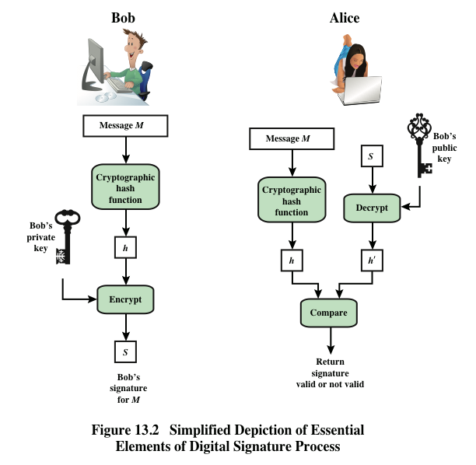
Notes:
In simplified terms, the essence of the
digital signature mechanism is shown in Figure 13.2. This repeats the logic shown in
Figure 11.4. A worked-out example, using RSA, is available at this book’s Premium
Content Web site.

Slide 51
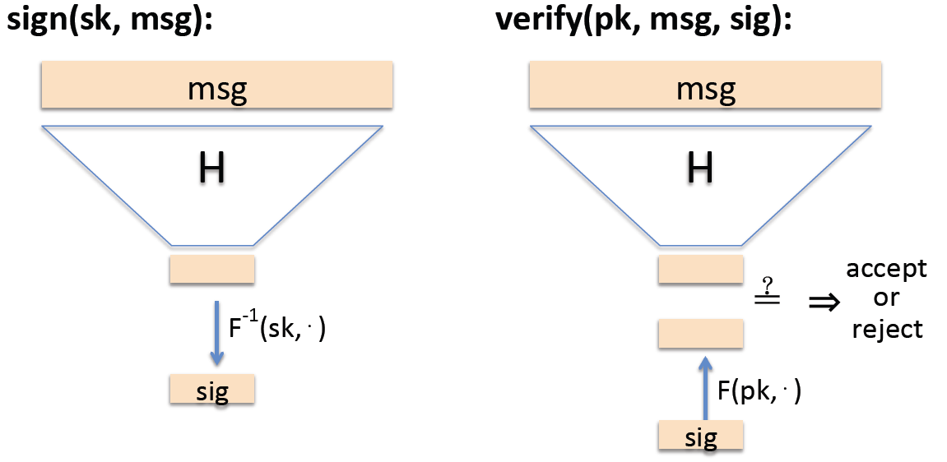
数字签名
解决方案：构造依赖于文本的签名
例如：使用RSA实现数字签名
1. 密钥的生成（同加密系统）
公钥Pk={e,n};私钥Sk={d,n}。
2. 签名过程 (用d,n) 明文：M<n
密文：S=M^{d}(mod n).
3. 验证过程 (用e,n)
给定M，S，Ver（M，S）为真，当且仅当，M=S^{e}（mod n)
数字签名算法除了基于RSA的算法外，还有ElGamal签名算法、Schnorr签名算法和DSA签名算法等。

Slide 52
RSA签名例程
用OpenSSL函数签名的例子
读入或产生RSA的key
签署一个报文
验证之
See “demo_sign,v2.zip”

Slide 53
数字签名标准
Digital Signature Standard （DSS）
Digital Signature Algorithm （DSA）
DSS标准--DSA
FIPS 186 NIST 1991 1993
只能签名，不能加密
概念对比
RSA：M＋E_{ki}(H(M))，k_{i}是私钥
DSS：M＋E_{ki}(H(M), k)，k_{i}是私钥 k是随机数

Slide 54
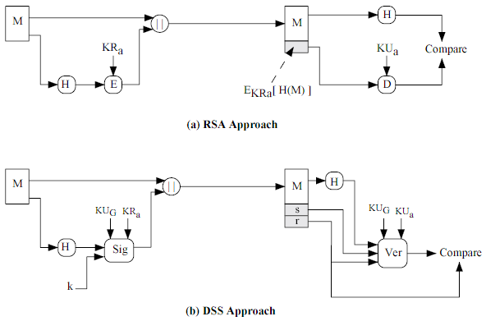
图示 RSA vs. DSS
KU_{G}是一组参数，称为全局公钥

Slide 55
DSA算法 in OpenSSL
OpenSSL支持DSA签名算法
包括：
DSA密钥产生
对文件签名
验证
Notes:
OpenSLL

Slide 56
特殊用途的签名体制
特殊目的签名有很多种，比较典型的几类有盲签名、群签名、环签名、代理签名、一次性签名、、不可否认签名、签密、等等
一次性签名：著名的Lamport签名，签名的公私钥对只能使用一次，使用多次则容易被伪造签名，由于其实现和计算简单而主要用在芯片卡等应用中
不可否认性签名：必须由签名者参与的条件下，才能验证签名，从而保护签名者的权益，以免在签名者不在场的情况下，有人拿着其签名进行相关操作
群签名(Group Signature)是面向群体密码学中的一个课题，1991年由Chaum和van Heyst提出。它有下述几个特点：①只有群中成员能代表群体签名；② 接收到签名的人可以用公钥验证群签名，但不可能知道由群体中那个成员所签；③ 发生争议时可由群体中的成员或可信赖机构识别群签名的签名者。这类签名可用于投标中，以防止作弊

Slide 57
电子签名法
《中华人民共和国电子签名法》
http://www.mii.gov.cn/art/2005/12/15/art_522_1320.html
第十四条 可靠的电子签名与手写签名或者盖章具有同等的法律效力。

Slide 58
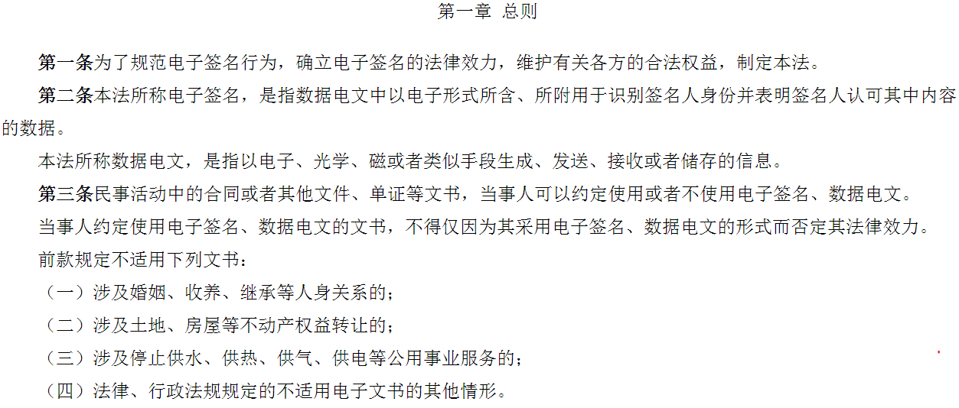

Slide 59
小结
数字签名的法律地位已经被确立。
在签名算法前一般都先对消息执行Hash算法，因此Hash算法的安全性也备受关注，尤其是MD5分析上的重大进展。

Slide 61
基于生日悖论的碰撞攻击
发送方A准备文本消息x进行签名，用A的私钥对m位的hash值加密并将加密后的hash值附于消息后。
攻击者产生该消息x的2^{m/2}种变形x’，且每种变形表达相同的意义，将这些消息以及对应的hash值存储起来。
攻击者伪造一条消息y，并想获取A的签名
攻击者再产生消息y的变形y’，每个变形y’与y表达相同的意义。对于每个y’攻击者计算H(y’)，并与任意的H(x’)进行对比，重复这一过程直到碰撞出现。
攻击者将该合法消息的变形x’提供给A签名，并将该签名附于附于伪造消息的变形y’后并发送给预期的接收方，因为x’和y’的hash值相同，所以签名也相同。

Slide 62
基于分组密码链接的hash函数
消息M分成固定大小的分组M1, M2…Mn，使用对称加密机制，如：DES，
计算： H0 = 初始值
Hi = E（Mi，Hi-1）
hash = Hn
类似CBC方式，但是不使用密钥，而使用消息分组作为key
Rabin提出

Slide 63
Hash算法分析的新近进展
MD5CRK was a distributed project started in March 2004 with the aim of demonstrating that MD5 is practically insecure by finding a collision using a birthday attack生日攻击.
MD5CRK ended shortly after 17 August 2004, when collisions for the full MD5 were announced by Xiaoyun Wang, Dengguo Feng, Xuejia Lai and Hongbo Yu [1] [2]. Their analytical attack was reported to take only one hour on an IBM p690 cluster.
On 1 March 2005, Arjen Lenstra, Xiaoyun Wang, and Benne de Weger demonstrated [3] construction of two X.509 certificates with different public keys and the same MD5 hash, a demonstrably practical collision. The construction included private keys for both public keys.
Notes:
And a few days later, Vlastimil Klima described [4] an improved algorithm, able to construct MD5 collisions in a few hours on a single notebook computer. On 18 March 2006, Klima published an algorithm [5] that can find a collision within one minute on a single notebook computer, using a method he calls tunneling.
form Wikipdia
王晓云在论文里写了： 信息x 计算其md5为 y， 现在在已知x（这点非常重要）情况下可以很快计算出一个z(z内容基本是随机的） 其md5也是y。 即知道x，可以快速找到一个z，使得md5(x) == md5(z) == y 导致无法直接威胁当前安全体系的原因有两个： 1. 只知道md5值y，而不知道原信息x情况下无法找到一个信息让其md5值为y，也就是说你知道了md5情况下也找不出密码。 2. 知道x情况下可快速找到z使得两者md5值相等，但无法控制z的内容，z几乎就是随机字符。也就是说你知道了 x内容，想串改x内容为有意义的z，还想x和z的md5值相同，这是不可能的。
王小云的主要工作是关于hash函数的破解工作。她在2005一个密码学会议上宣布破解了SHA-1，震惊了全世界。所以要介绍和理解她的工作，先看一下hash函数具体是怎么回事。
阅微堂 数学、金融、计算机
博客 » 计算机科学 » hash函数，MD5，SHA-1，密码学，王小云，理论计算机初步 »
理论计算机初步：从hash函数到王小云的MD5破解
作者：张志强， 发表于 2006年9月18日
系列：理论计算机初步 查看该系列所有文章
密码学是理论计算机的一个很大的方向。之前准备先写密码学概论再提在hash函数破解上做出重大贡献的王小云教授的工作，不过前两天王小云获得求是杰出科学家奖以及100万奖金，在媒体上又掀起了一轮宣传狂潮，但是有些报道极端弱智，错误百出，所以我趁机纠正一下，并介绍密码学的一个组成部分——hash函数，以及王小云在这上面的工作。
王小云的主要工作是关于hash函数的破解工作。她在2005一个密码学会议上宣布破解了SHA-1，震惊了全世界。所以要介绍和理解她的工作，先看一下hash函数具体是怎么回事。
简单的说，hash函数就是把任意长的输入字符串变化成固定长的输出字符串的一种函数。通俗得说，hash函数用来生成信息的摘要。输出字符串的长度称为hash函数的位数。
目前应用最为广泛的hash函数是SHA-1和MD5，大多是128位和更长。
hash函数在现实生活中应用十分广泛。很多下载网站都提供下载文件的MD5码校验，可以用来判别文件是否完整。另外，比如在WordPress的数据库，所有密码都是保存的MD5码，这样即使数据库的管理员也无法知道用户的原始密码，避免隐私泄露（很多人在不同地方都是用的同一个密码）。
如果两个输入串的hash函数的值一样，则称这两个串是一个碰撞(Collision)。既然是把任意长度的字符串变成固定长度的字符串，所以，必有一个输出串对应无穷多个输入串，碰撞是必然存在的。
一个「优良」的hash函数 f 应当满足以下三个条件：
任意y，找x，使得f(x)=y，非常困难。
给定x1，找x2，使得f(x1)=f(x2)，非常困难。
找x1，x2，使得f(x1)=f(x2)，非常困难。
上面的「非常困难」的意思是除了枚举外不可能有别的更快的方法。比如第3条，根据生日定理，要想找到这样的x1，x2，理论上需要大约2^(n/2)的枚举次数。
王小云的主要工作是给出了MD5，SHA-0的碰撞，以及SHA-1的理论破解，她证明了160位SHA-1，只需要大约2^69次计算就能找出来，而理论值是2^80次。她的寻找MD5碰撞的方法是极端高效的。传说王小云当时在会议上把碰撞写出来，结果被下面的人验证发现不对，原来她把MD5算法的一个步骤弄错了。但是她立马联系她的当时留在中国的学生，修正算法，并找到一个新的碰撞。这一个是对的。

Slide 64
签名在安全电子邮件中的应用
侧重保密
A－B：E_{ks}(M) || E_{kb}(Ks)， Kb是b的公钥
侧重鉴别，不保密
A－B：M || E_{ka}(H(M))，ka是a的私钥
既保密又签名鉴别
A－B：E_{ks}(M || E_{ka}(H(M)))|| E_{kb}(Ks)
其中a的私钥，b的公钥
PGP
* 邮件应用的特点是非在线、非交互

Slide 65
SHA-512
输出512位，以1024位分组处理
寄存器初始值（8个64位寄存器a-h）
a = 6A09E667F3BCC908
b = BB67AE8584CAA73B
c = 3C6EF372FE94F82B
d = A54FF53A5F1D36F1
e = 510E527FADE682D1
f = 9B05688C2B3E6C1F
g = 1F83D9ABFB41BD6B
h = 5BE0CD19137E2179
Notes:
目前，MD5和SHA-1仍是最常用的散列算法。但是更长的散列算法如SHA-256/512等正在成为趋势。

Slide 66
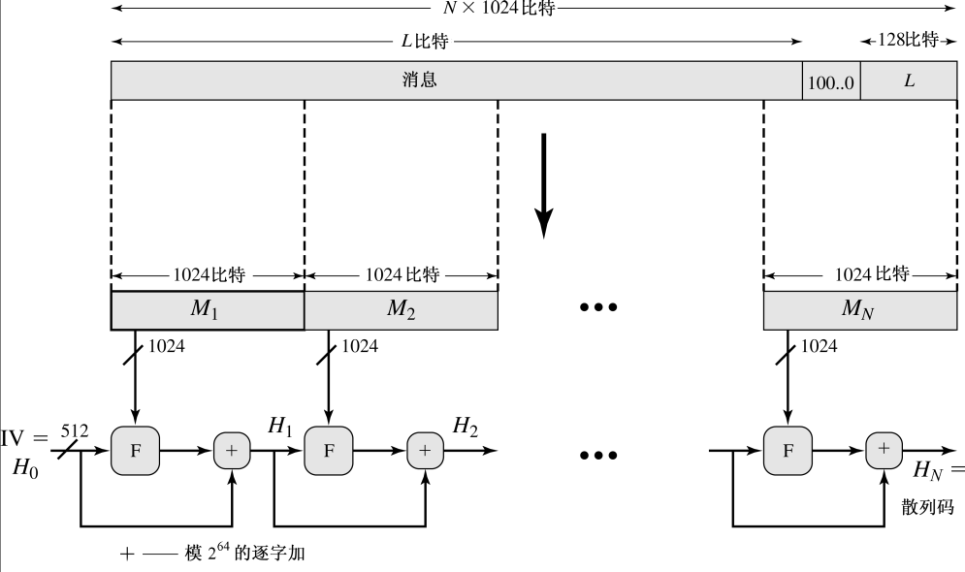
SHA-512 Overview

Slide 67
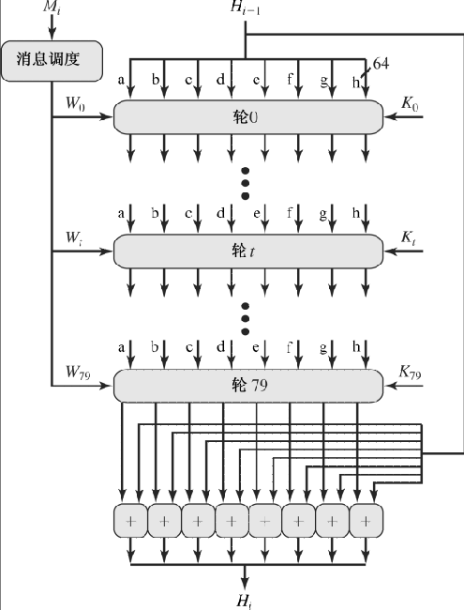
SHA-512 Round

Slide 68
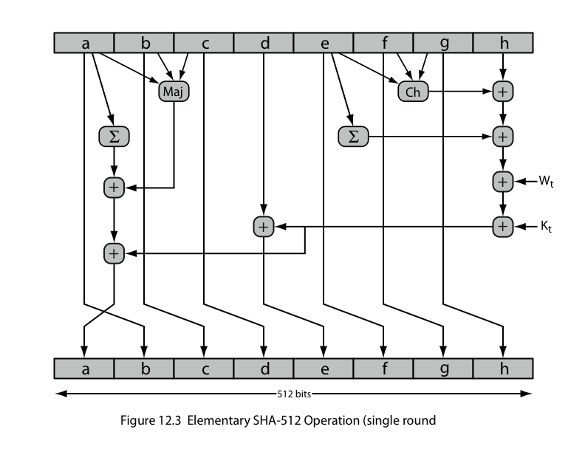
SHA-512 Round Function

Slide 69
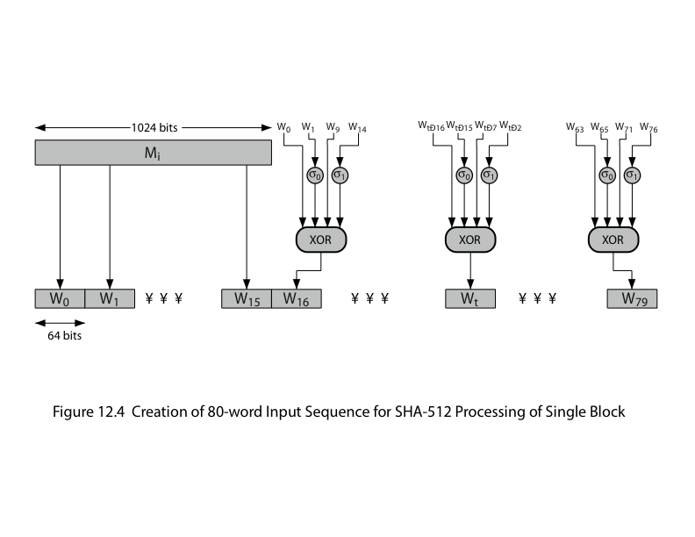
SHA-512 Round Function
Notes:
导出每轮所用的Wi，共80轮

Slide 70
SHA-512实现
SHA-256/384/512 implementation
http://freshmeat.net/projects/sha2/
Support for the SHA-256, SHA-384, and SHA-512 hash algorithms was added to the Sun provider. ---JDK 1.4.2
在OpenSSL-0.9.8d中还不支持，高版本已支持。
Notes:
int SHA_Init(SHA_CTX *c);
初始化SHA Context；
返回值： 1 成功，0 失败；
int SHA_Update(SHA_CTX *c, const void *data, size_t len); 用户循环调用此函数，可以将不同数据加在一起计算SHA1的值；
返回值： 1 成功，0失败；
int SHA_Final(unsigned char *md, SHA_CTX *c);
输出SHA1的数据；
返回值： 1 成功，0失败；
unsigned char *SHA(const unsigned char *d, size_t n, unsigned char *md); SHA_Init,SHA_Update,SHA_Final 三个函数的组合；直接计算出SHA1数值；
返回值： 1 成功， 0失败；
void SHA_Transform(SHA_CTX *c, const unsigned char *data);
传递数据，内部函数，用户不需使用此函数；

Slide 71
关于加密和认证分离
加密本身不能实现认证功能
认证和加密的分离带来灵活性
只要认证而不需保密
如公文，软件完整性鉴别(防病毒)、网络管理广播报文(如SNMP)等
不能加密的场合（如法规限制）
存档期间的保护（而不仅是传输期间）
Notes:
关于认证和加密：
有先hash在加密
先认证再加密：ssl
先加密再认证：ipsec
独立进行加密和认证：ssh

Slide 72
HMAC：带Key的Hash函数
利用HASH函数从报文和密钥产生MAC码
先计算特征，再把特征加密的思想，或
直接把散列函数和Key结合得MAC
HMAC = Hash_{Key}(Message)
比如
HMAC = Hash(Key || Message)

Slide 73
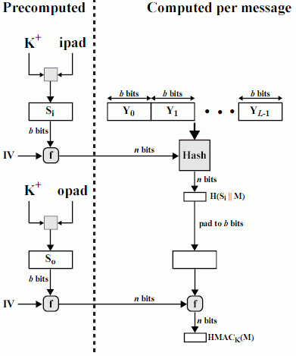
优化实现HMAC
适合一个Key产生多个小报文的MAC的情况

Slide 74
HMAC标准
RFC 2104
HMAC：Keyed-Hashing for Message Authentication
FIPS 198
The Keyed-Hash Message Authentication Code (HMAC)

Slide 75
HMAC标准
RFC 2104
HMAC：Keyed-Hashing for Message Authentication
FIPS 198
The Keyed-Hash Message Authentication Code (HMAC)

Slide 76
数字签名
消息认证基于共享秘密，不能防止抵赖
只是2方合作抵抗第3方窜改/假冒
共享的秘密不具有排他性质
双方有同样的不分彼此地能力；因此对某个报文的存在和有效性，每一方都不能证明是自己所为，或者是和自己无关
特异性
要想实现类似签名的安全能力，必须使每个人使用独有的秘密

Slide 77
用私钥加密当作签名
主要操作
输入 报文明文、私钥 m^d = s
输出 报文明文、报文密文(签名) (m, s)
验证 s^e =? m
是否满足签名要求的特性
讨论
私钥(其实是公钥)的管理: 和身份绑定、更新等
签名过程太慢: 启用散列函数
改进
对报文的散列值用私钥加密得到和n等宽的签名值

Slide 78
{回顾ElGamal加密体制}
准备
素数p，Z_{p}*中本原根a，公开参数
私钥Xa，公钥Ya=a^{xa} mod p
加密
对明文1<=m<=p-1，选随机数k, 计算K=(Ya)^{k} mod p
密文(c1, c2)
c1=a^{k} mod p, c2=KM mod p
解密
K=(C1)^{Xa} mode p M = (C2 K⁻¹) mod p
证明 K=(Ya)^{k} mod q = (a ^{Xa} mod p)^{k} mod p = a ^{kXa} mod p
K= (C1)^{Xa} mod p, 又C2=KM mod p, (C2K⁻¹)mod p=KMK⁻¹ mod p= M mod p=M

Slide 79
ElGamal签名方案
Z_{p}满足离散对数问题难解，α是本原根
设P ＝ Z_{p}* ，
K ＝{(p,α, Xa,Ya), Ya=α^{xa} (mod p) }
私钥是Xa，公钥是{Ya, p,α}
对消息M签名时，先计算m=H(M)
签名时，取秘密随机数k∈Z_{p-1}*，k⁻¹为k模p-1的逆
定义sig(x,k) = (S1,S2),
＝(α^{k} mod p, (m-XaS1)k⁻¹ mod (p-1))
验证
ver(m, (S1,S2))： 验证V1 ＝? V2
V1= a^{m} mod p, V2=(Ya)^{S1} (S1)^{S2} mod p

Slide 80
签名计算实例
p＝467，α＝2，Xa＝127，则
Ya＝αª mod p ＝ 2¹²⁷ mod 467 ＝ 132
签名m＝100，取k＝213(注: k和p-1互素)，则
k⁻¹＝213⁻¹ mod 466 = 431
S1＝α^{k} mod p ＝ 2²¹³ mod 467 ＝ 29
S2＝ (m-XaS1) k⁻¹ mod Φ(p)
＝ (100-127×29)×431 mod 466
＝51
签名值：（100，(29,51)）

Slide 81
验证计算实例
p＝467，α＝2，Xa＝127, Ya＝ 132
（m,(s1,s2)）＝（100，(29,51)）
判断是否 (Ya)^{s1}(S1)^{s2} mod p＝α^{m} mod p
事实上
(Ya)^{s1}(S1)^{s2} ＝132²⁹×29⁵¹＝189 mod 467
α^{m}＝2¹⁰⁰＝189 mod 467
而且，如果（100，(29,51)）的任何改变都会导致验证失败

Slide 82
图示 RSA vs. DSS
KU_{G}是一组参数，称为全局公钥

Slide 83
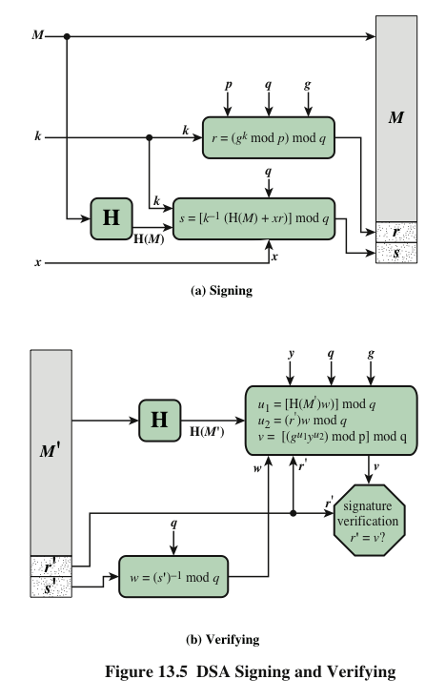
DSA Figure

